Slide 1


Web Constraints Solution Strategies
Subject Name: Platform Based Development
Subject Code: PBDV301 | PBDE401
Lecturer Name : Freedom
Department : Information Technology

Slide 2
Question
Which strategy primarily ensures a web app remains available during server failure?
A. Minifying CSS
B. Load balancing with failover
C. Using responsive design
D. Adding animations

Slide 3
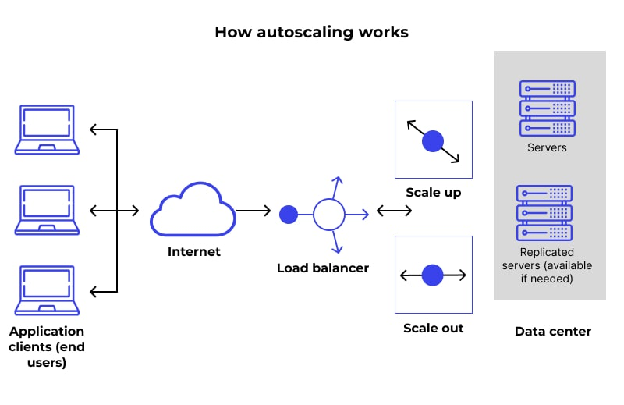
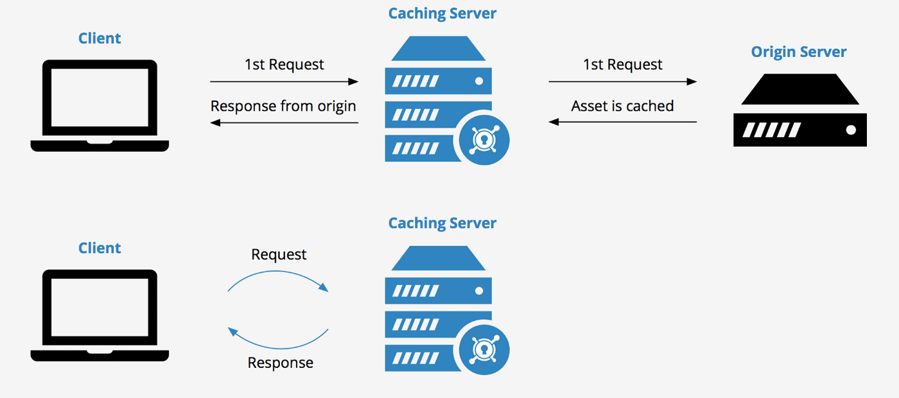
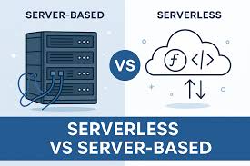
Server Dependency
Load balance and Auto-scaling
Caching

Slide 4
Question
What is the main purpose of using Babel in web development?
A. Compress images
B. Convert modern JavaScript into backward-compatible versions
C. Improve database indexing
D. Replace CSS frameworks

Slide 5
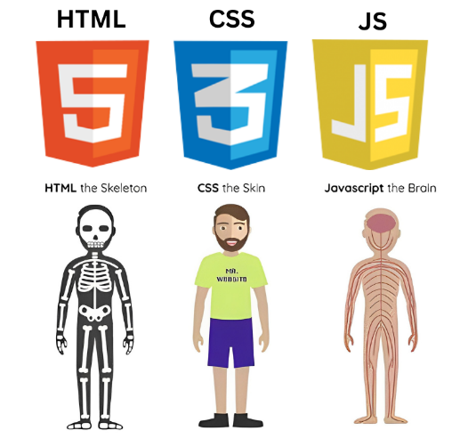
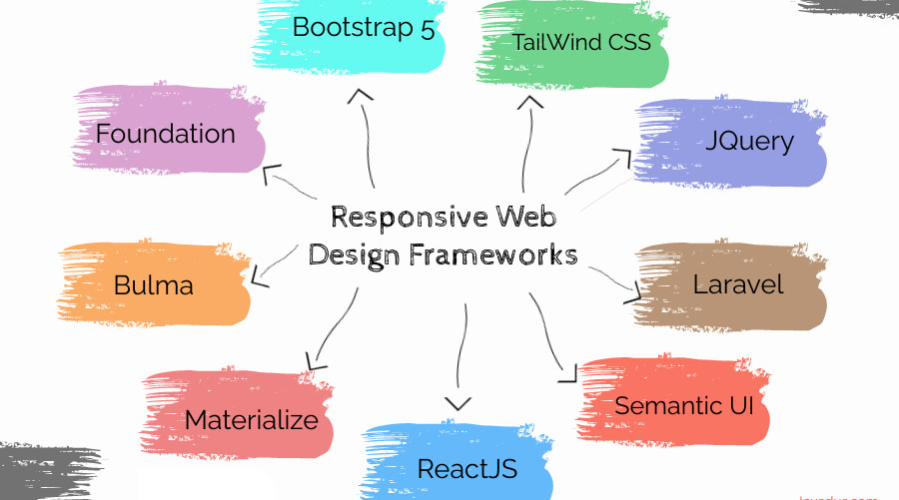
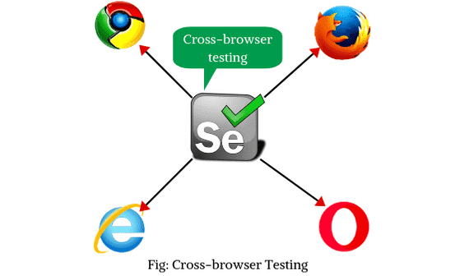
Incompatible Browsers
Standardized

Slide 6
Question
Which CSS feature is commonly used to implement responsive layouts?
A. Media Queries
B. SQL Queries
C. Stored Procedures
D. Cookies

Slide 7
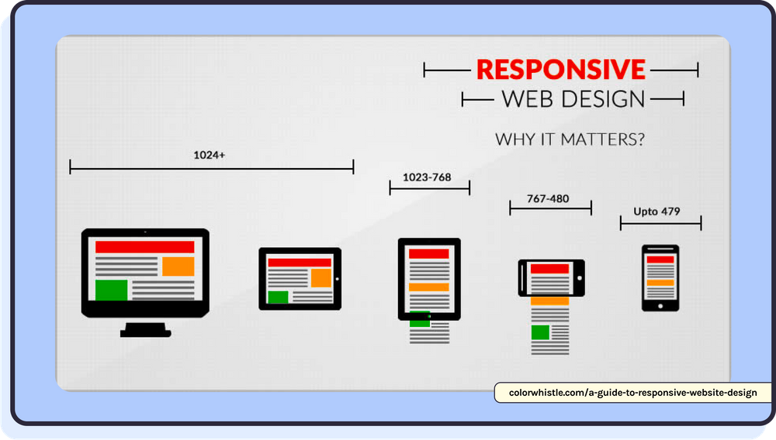
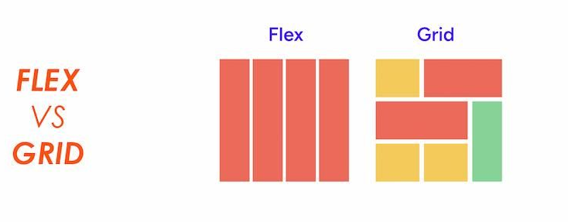
Lack of Responsiveness
Test across multiple devices and screen resolutions

Slide 8
Question
Which technology enables offline functionality in web apps?
A. Service Workers
B. REST APIs
C. FTP
D. SOAP

Slide 9
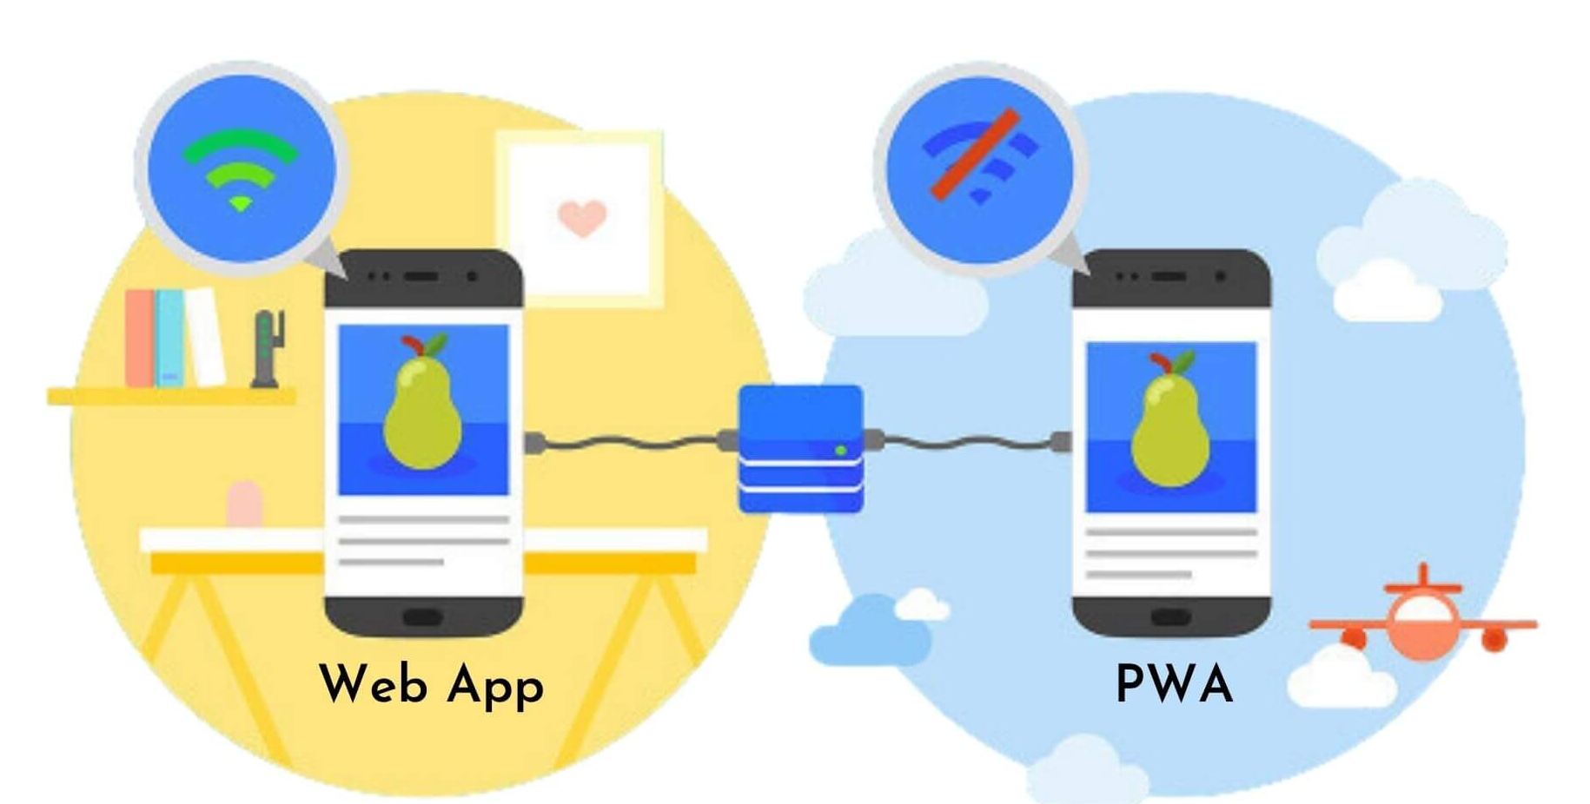
Internet Reliance
Restricted critical
functionality?
Local Storage or IndexedDB ( Store critical data locally)
Enable Caching of Static assets

Slide 10
Question
What is the primary benefit of using a CDN?
A. Encrypting passwords
B. Reducing latency by serving content closer to users
C. Writing backend logic
D. Creating databases

Slide 11
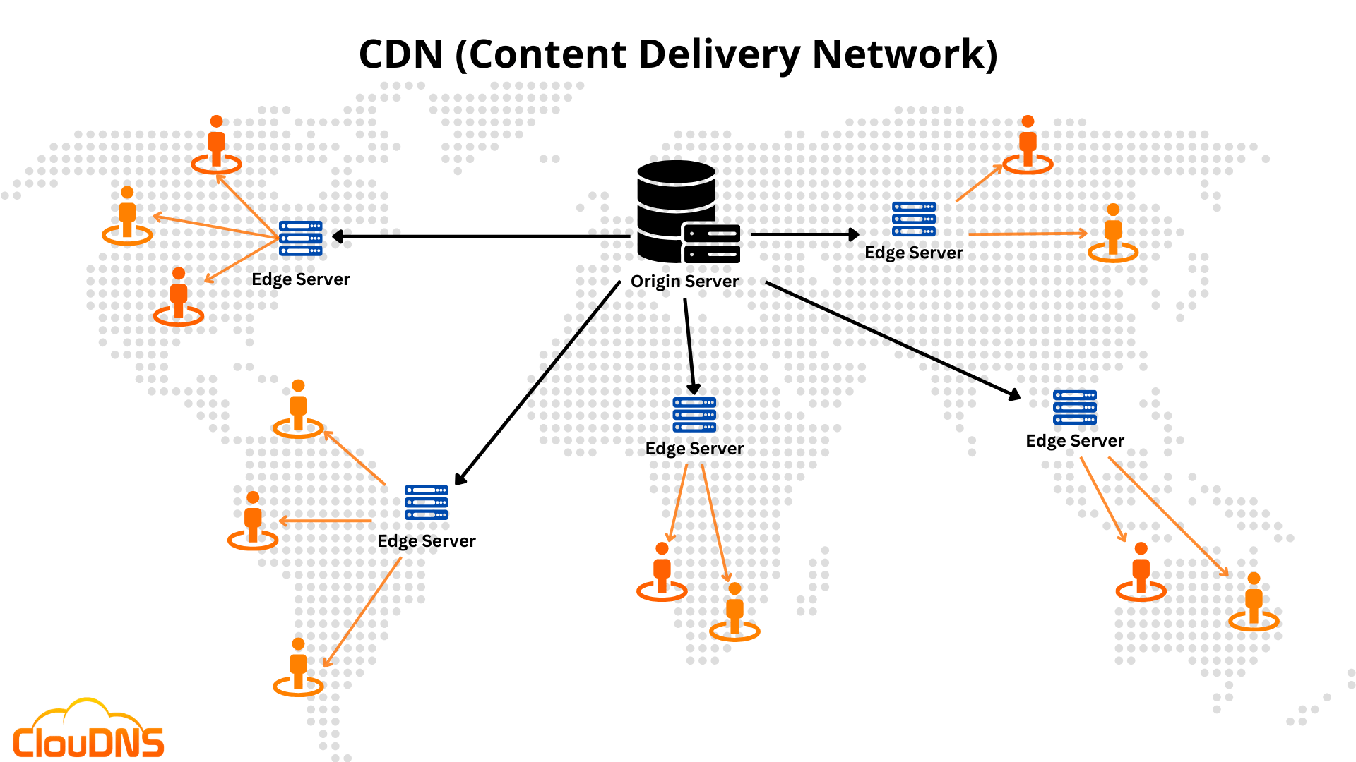
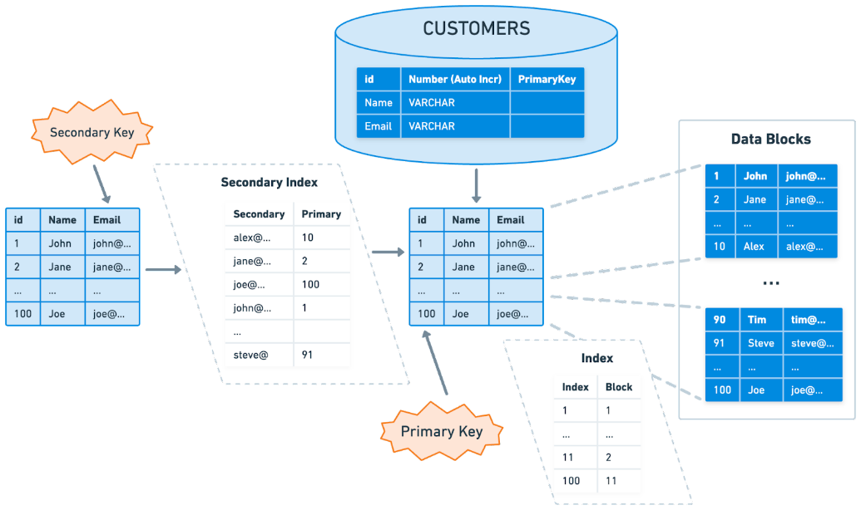
Reduced Speed/Performance
Database Indexing

Slide 12
Question
Which attack involves injecting malicious scripts into webpages?
A. SQL Injection
B. XSS
C. DDoS
D. Phishing

Slide 13
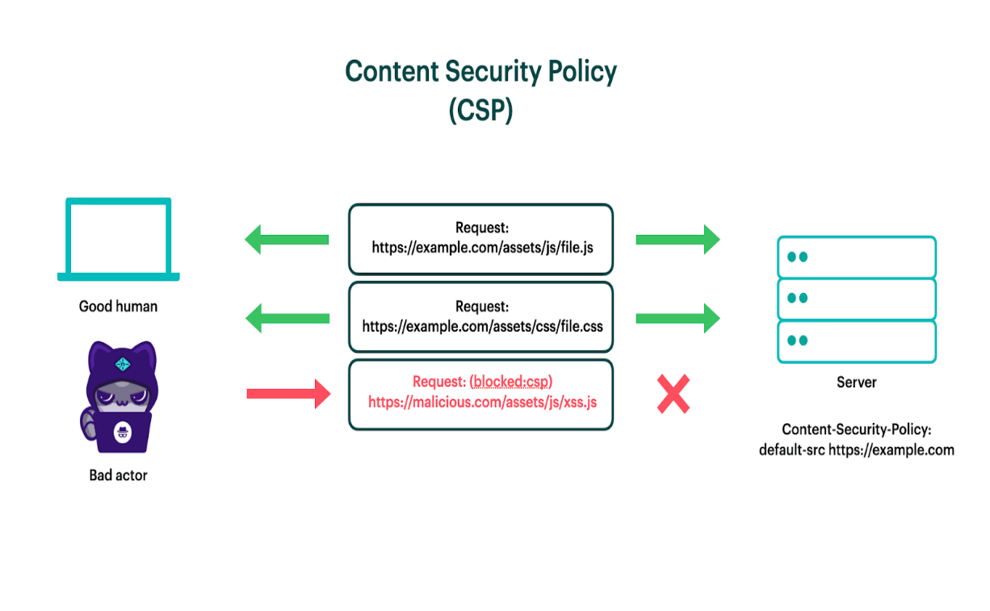
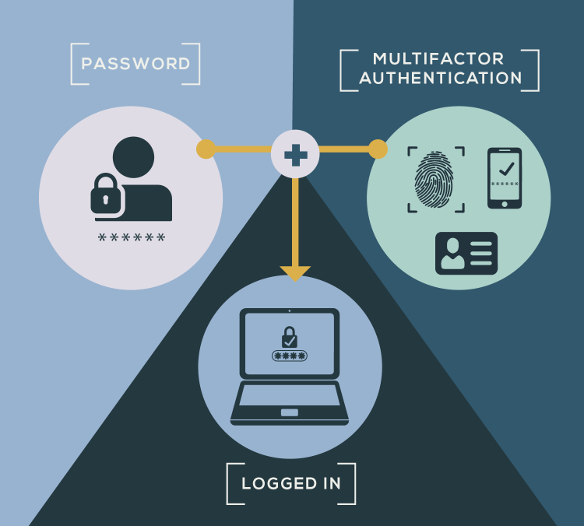
Less Security (Security Threats)

Slide 14
Question
Which solution directly reduces the size of data sent from the server to the client?
A. Increasing CPU power
B. Pagination
C. Adding more animations
D. Expanding database storage

Slide 15
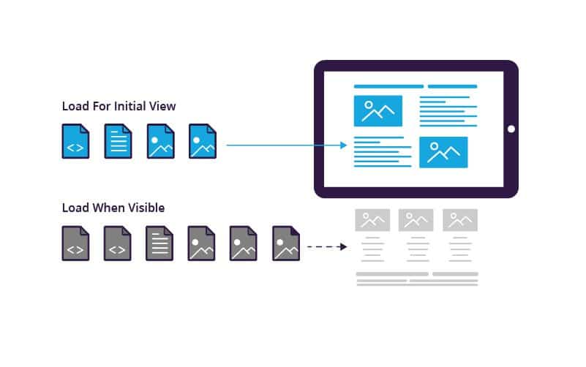
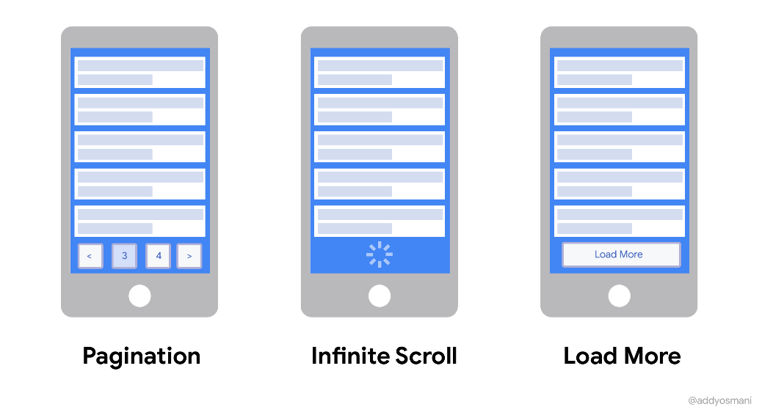
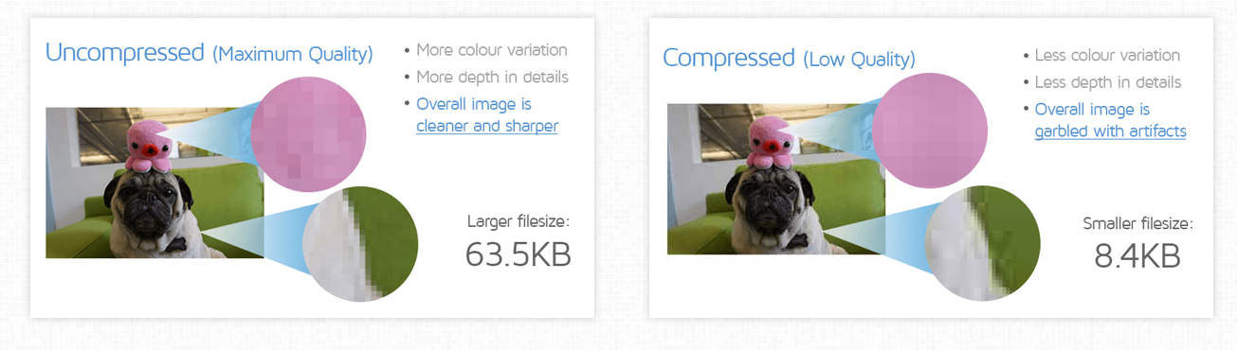
Data Transfer Size
Pagination and Lazy loading
Image Optimization

Slide 16
Question
What is a key requirement of GDPR?
A. Unlimited data storage
B. Explicit user consent for data collection
C. Public sharing of user data
D. No encryption required

Slide 17
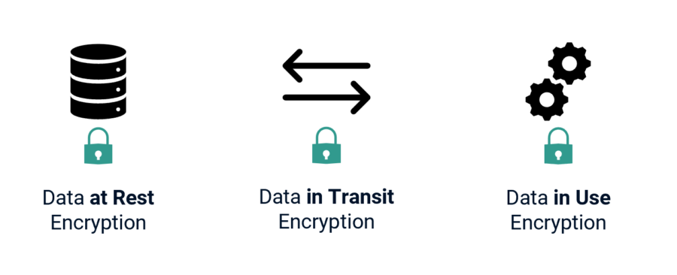
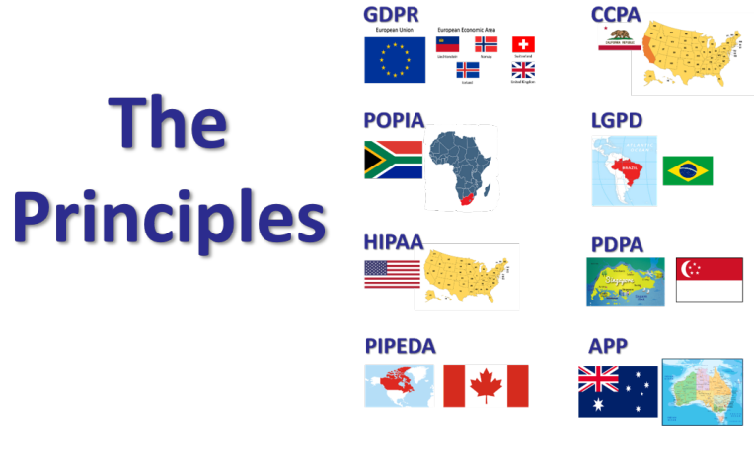
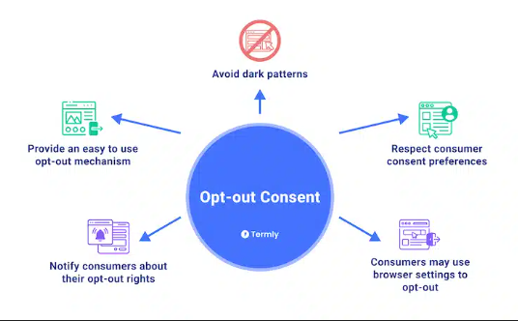
Compliance with Data-Related Laws

